Slide 1


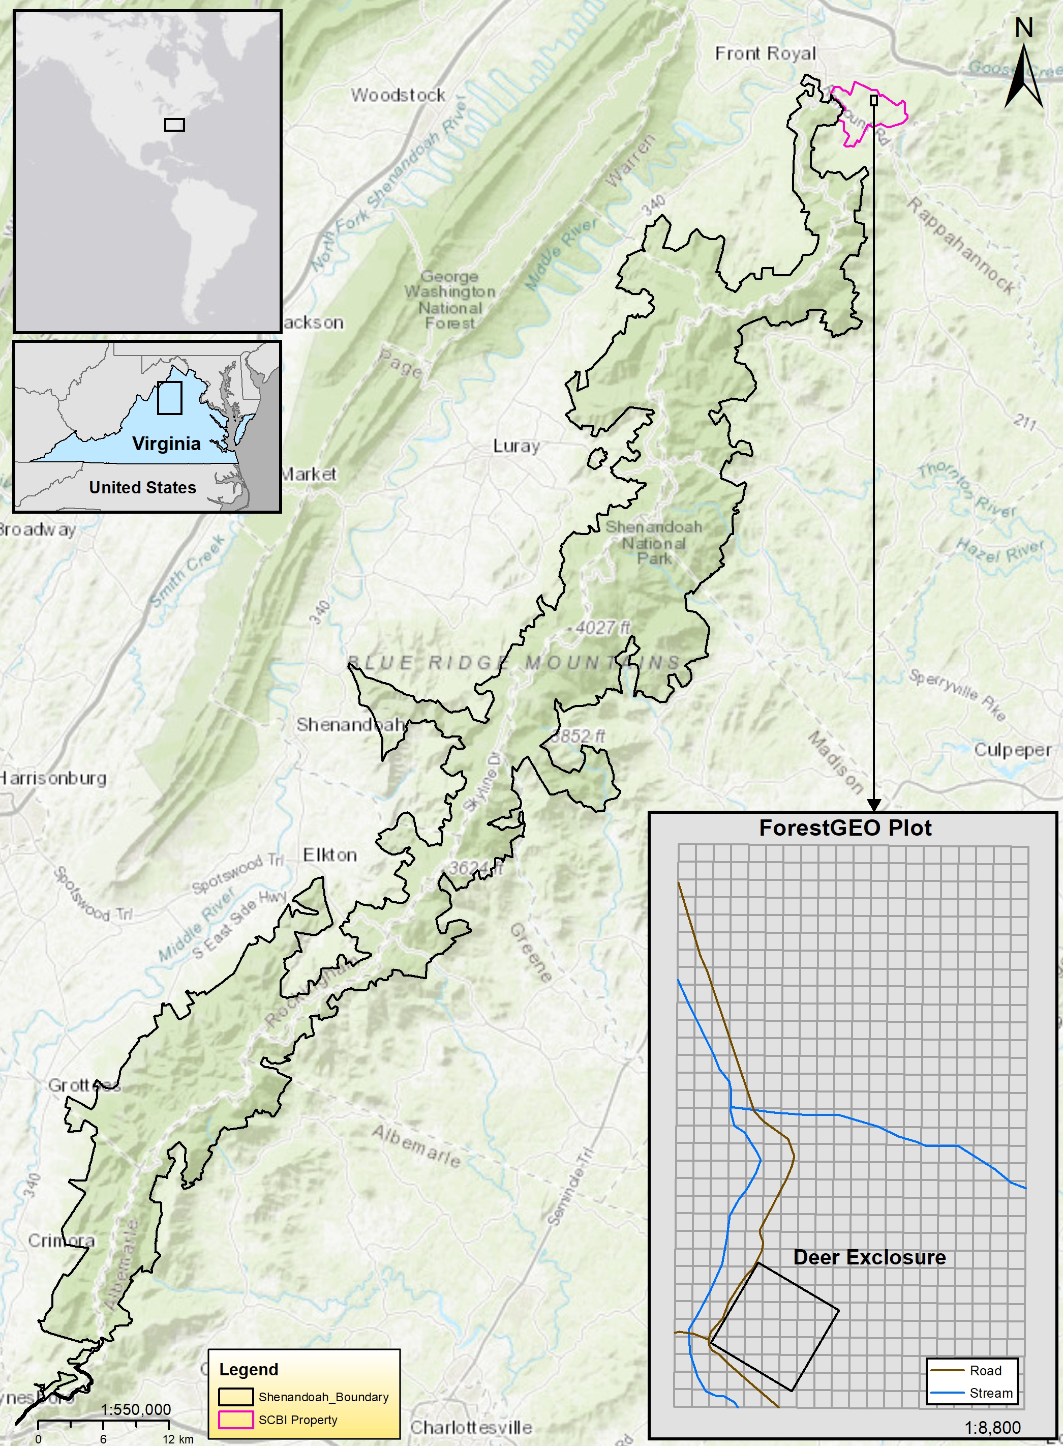
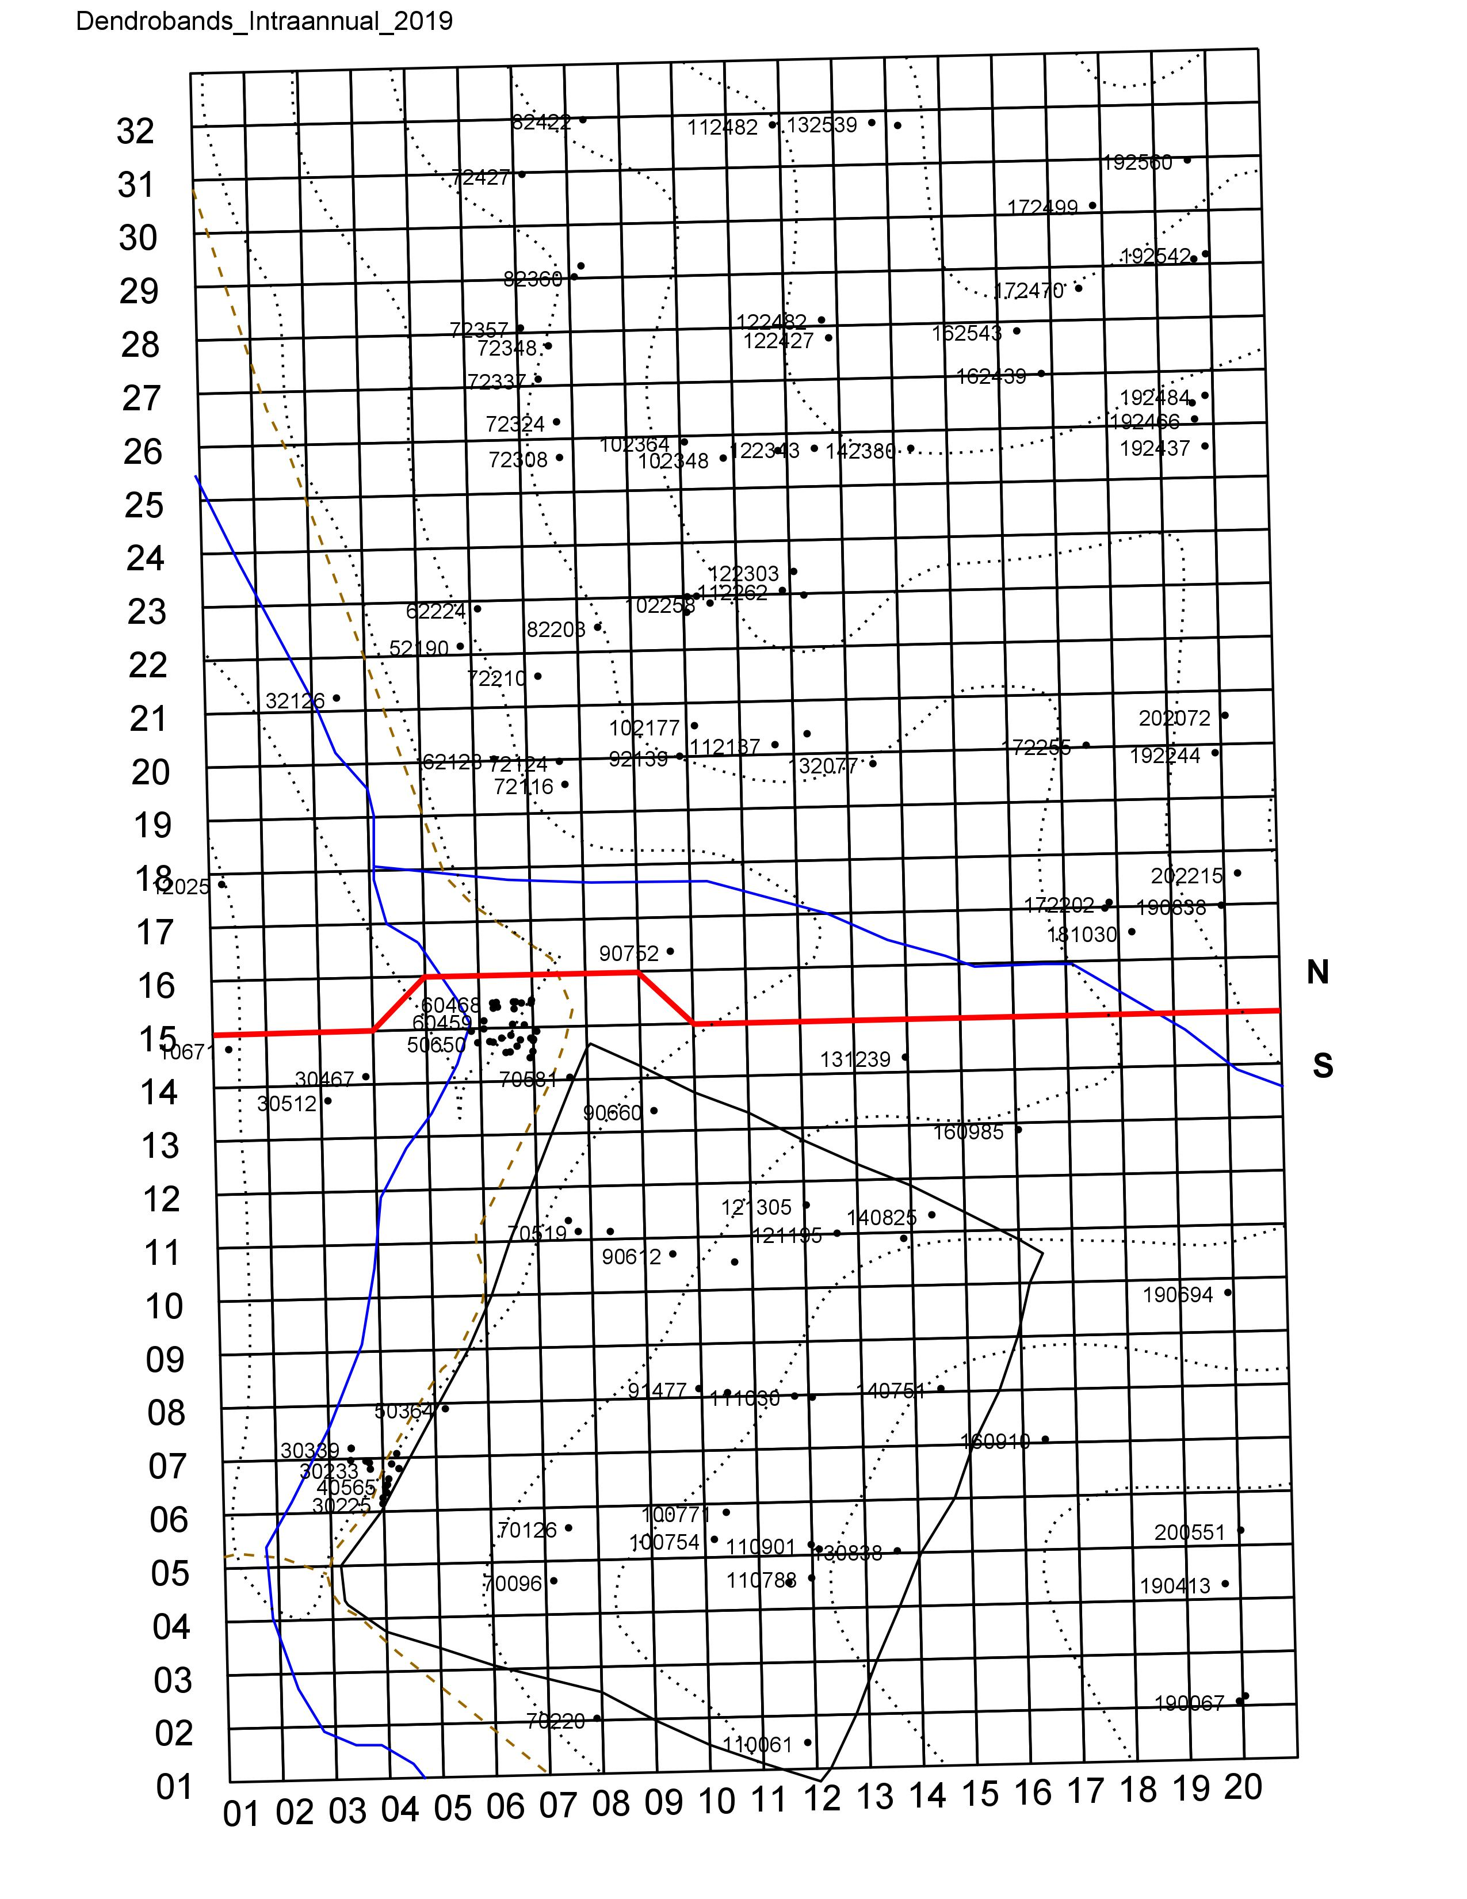
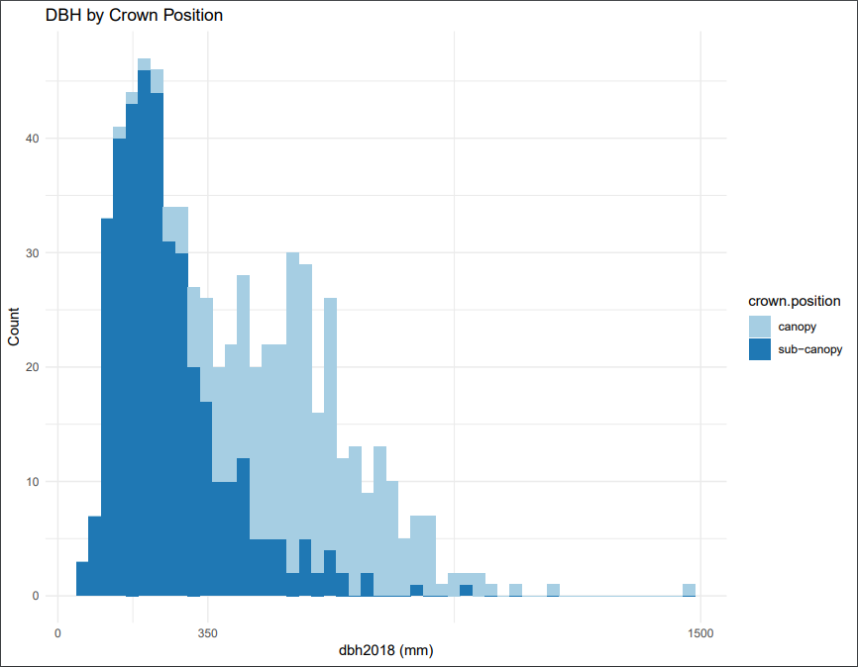
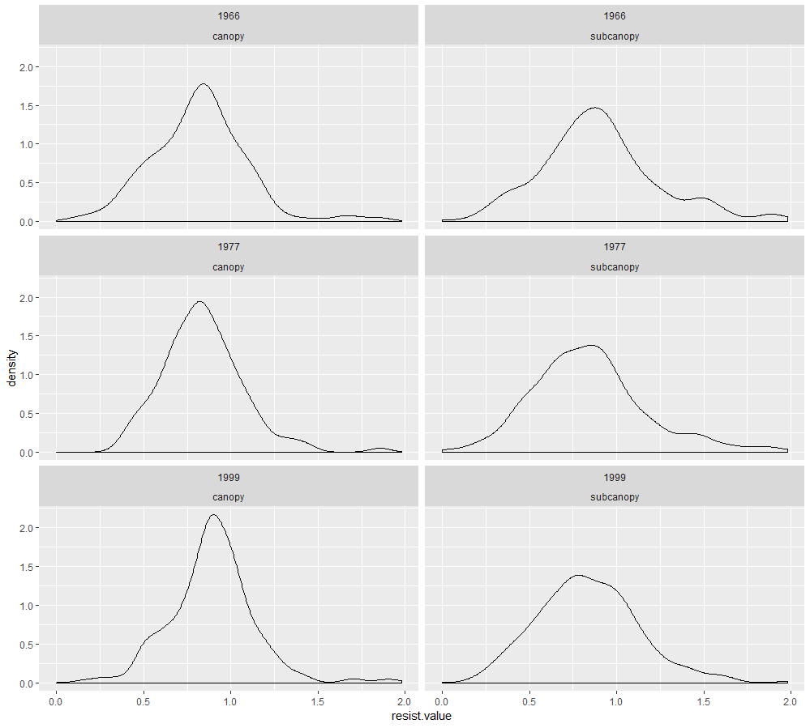
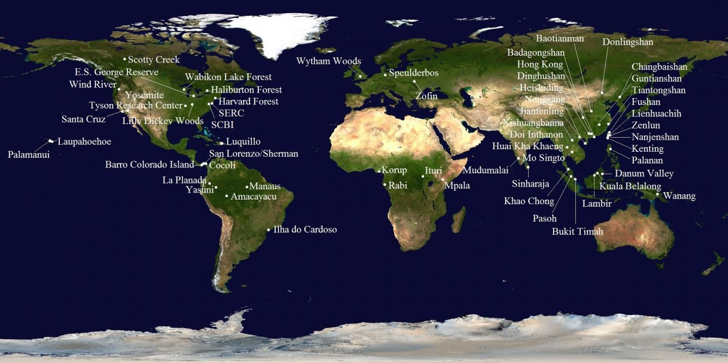
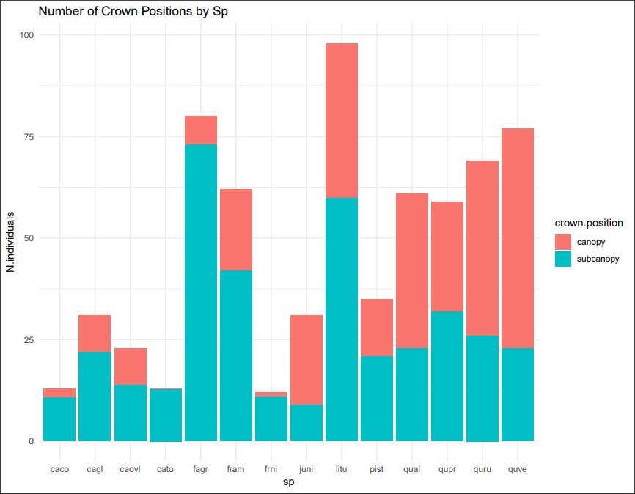
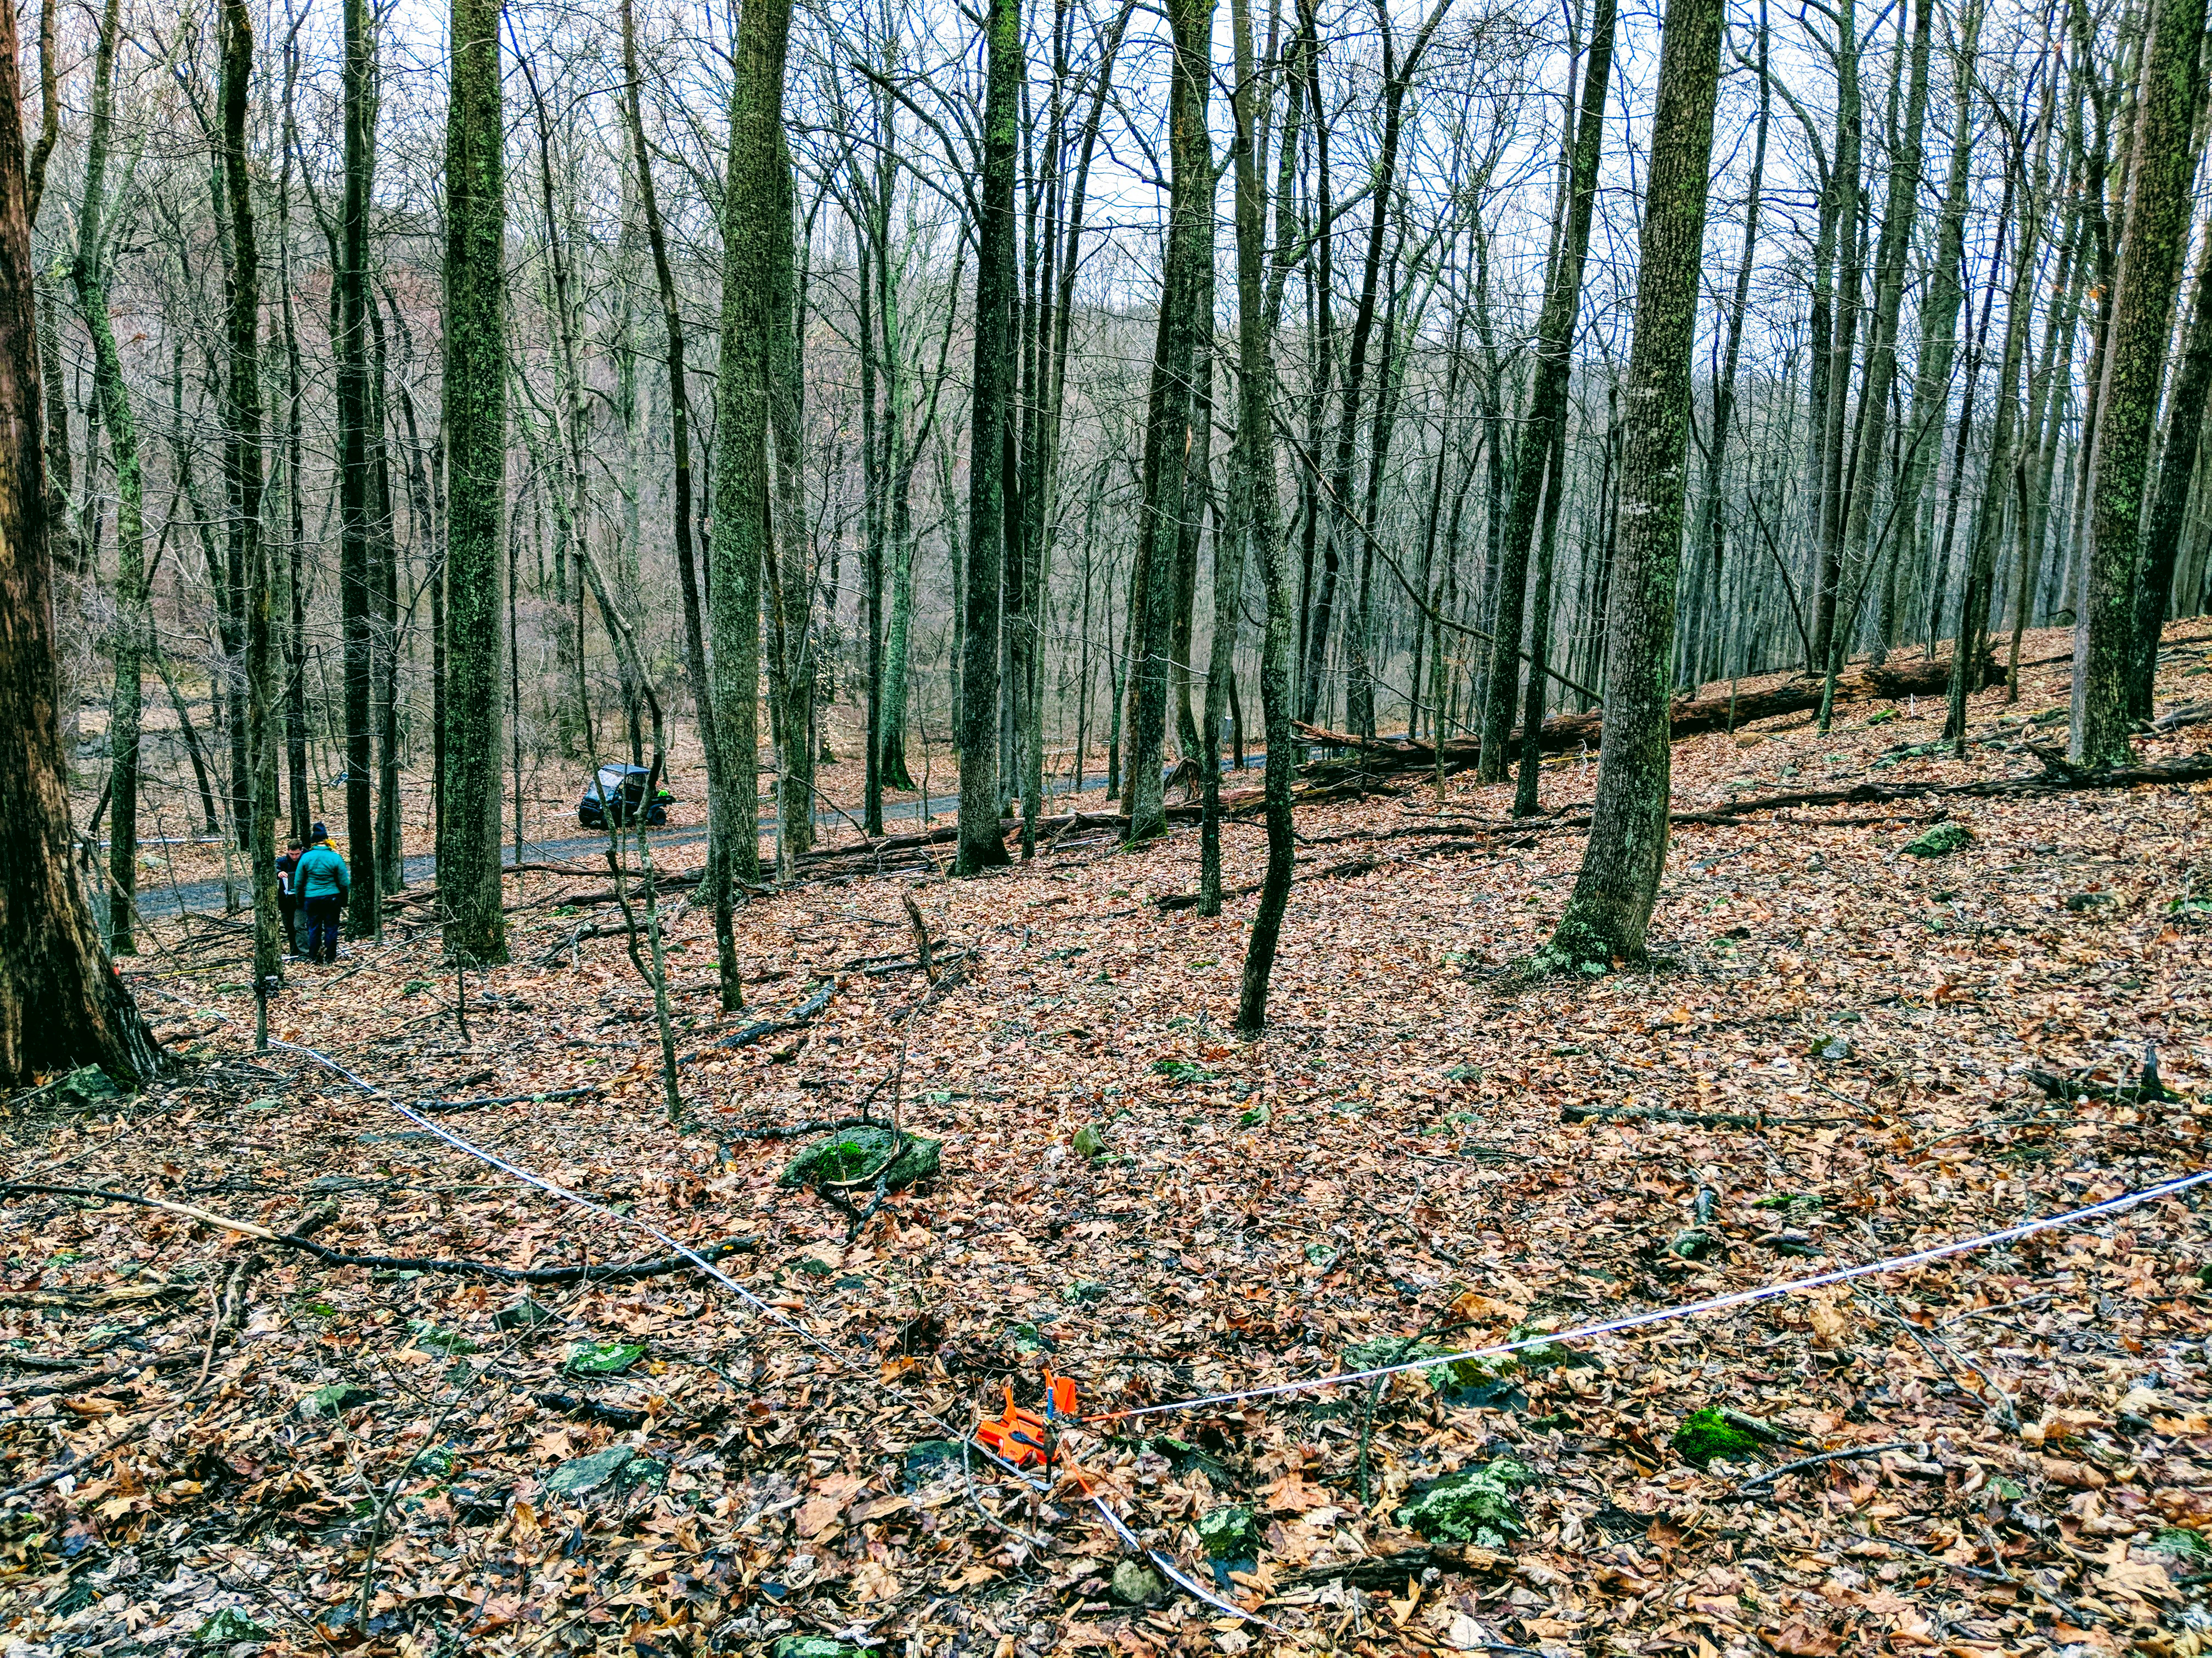
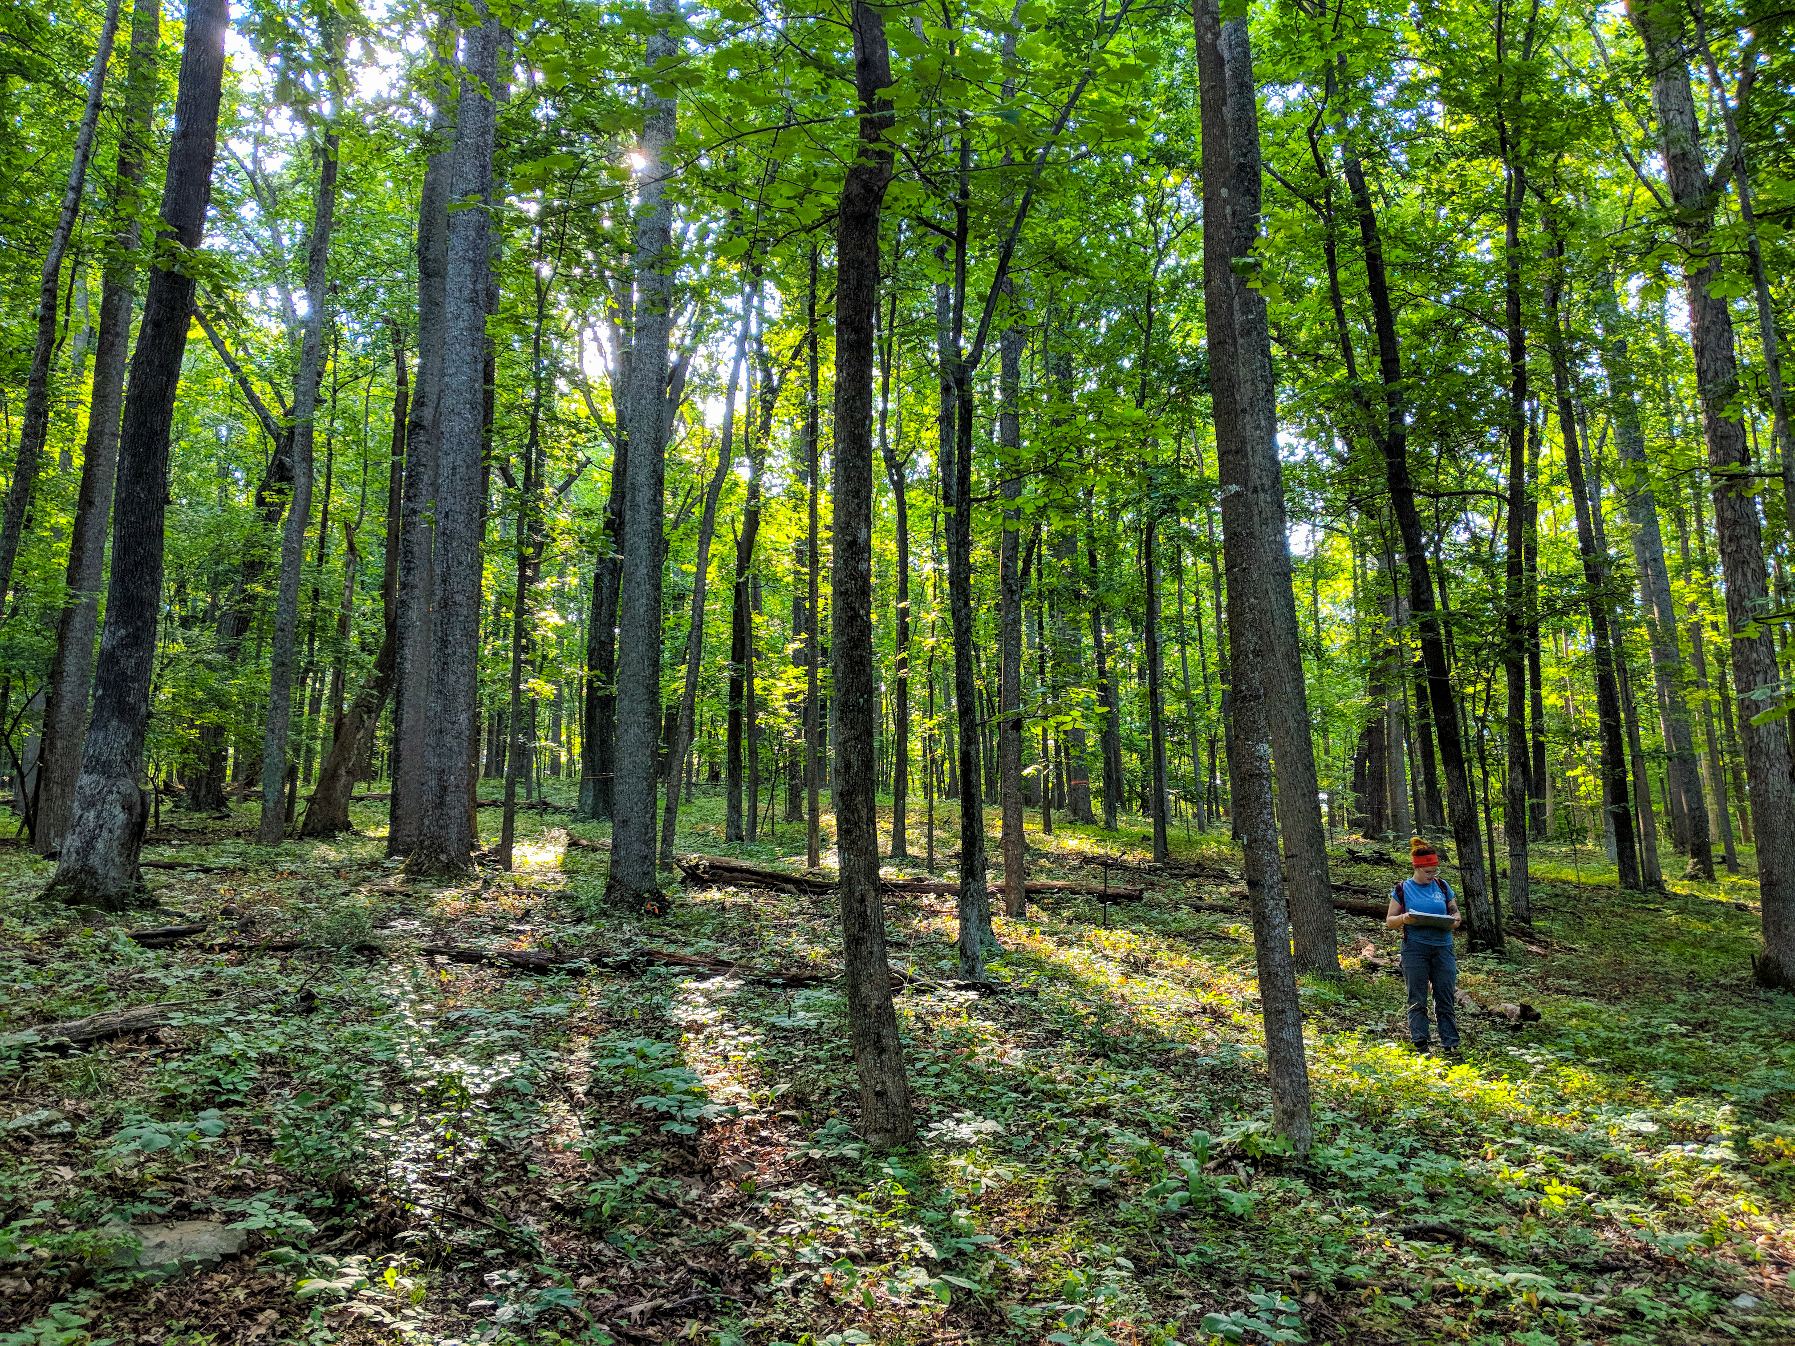
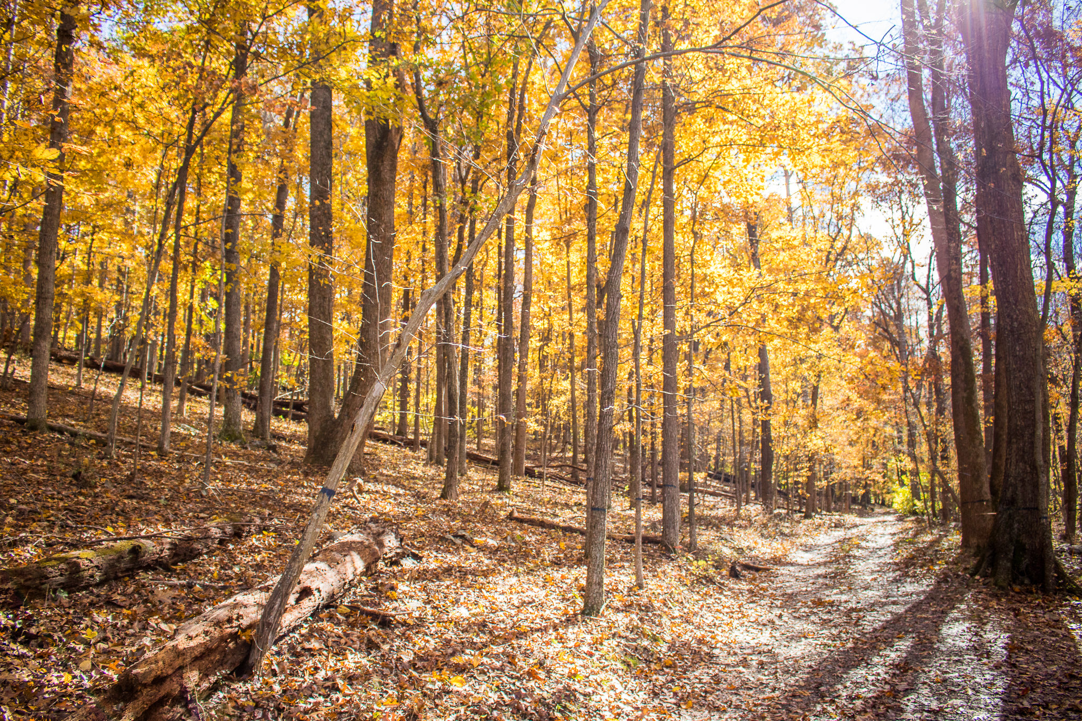
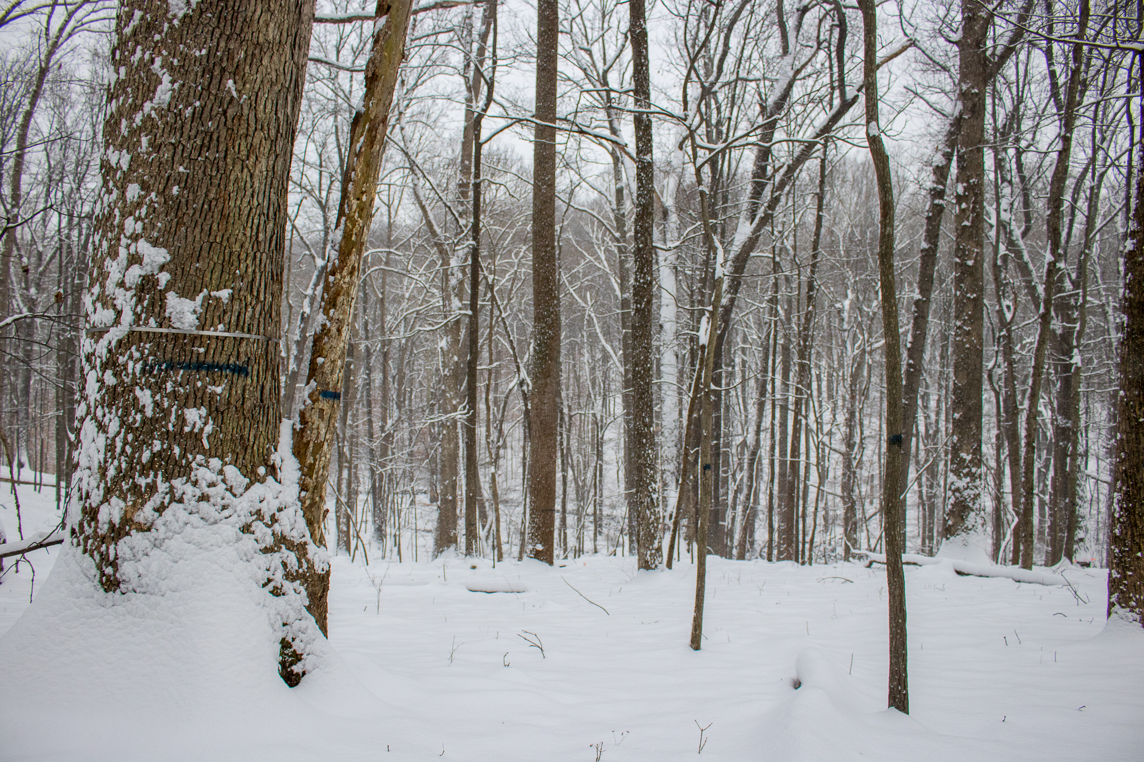
Tree Growth and Mortality
A Temperate Deciduous Forest in an Era of Global Change
Contributors: Ian McGregor, Kristina Anderson-Teixeira, Ryan Helcoski, Norm Bourg, William McShea, Erika Gonzalez, Valentine Herrmann
The Forest at SCBI
Tall Trees Grow Best! …Right?
When Attackers Come to Play
Why Forests?
They support biodiversity
Sustain half of all known species
Ecosystem services
They regulate climate
Contain 45% of carbon in the terrestrial biosphere
They are threatened
Global change pressures
(including climate change, pollution, agricultural expansion, logging, non-timber forest product extraction, hunting, and the spread of invasive species) threaten biodiversity, alter community composition, and drive feedbacks to climate change
How does climatic variation affect tree growth?
Trends for different climate variables dependent on timescale
Most influential climate variables tend to be
potential evapotranspiration (PET)
wet day frequency (WET)
PET minus precipitation (PRE)
Pests and Pathogens causing mortality
Ryan’s poster
Mortality survey data?
Graphs from ForestGEO census?
Which trees are most climate-sensitive?
It is dependent, it seems, on canopy position
Canopy trees are more affected by drought than sub-canopy
Increased mortality, stress, and invasive pests
Analyses on local trees in the SCBI plot confirm this
Comparing resistance index values (preliminary results)
ForestGEO
Global Earth Observatory
67 forest research sites around the world
Standardized survey protocol
Monitored continuously as early as 1981
Started in 2008 at SCBI
640 x 400m, 25.6 ha
https://www.eurekalert.org/multimedia/pub/80009.php
Sources: (will be size 14 font later)
Some writing here indicating the vast amount of knowledge we’re using.
Gonzalez-Akre et al 2016

